Slide 1

Aula Magna
Aula 02
2 TDSPN
Python, Machine Learning, Iris Project

Slide 2



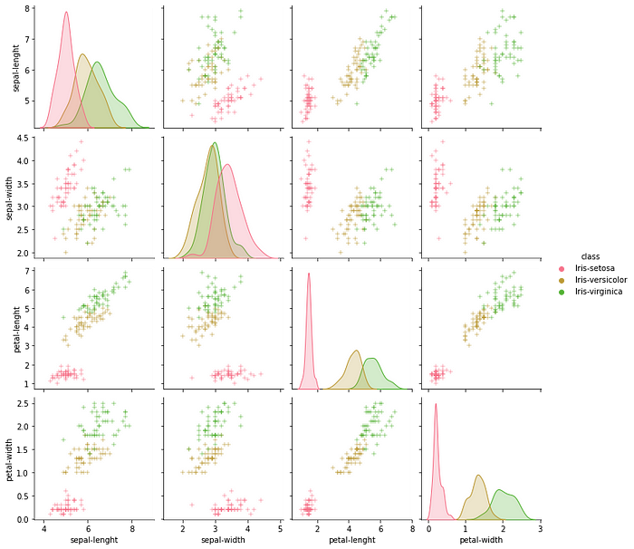
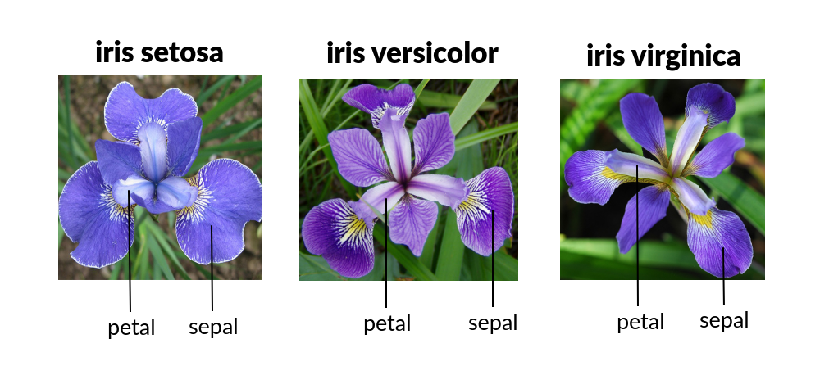
Entrada
Processamento
Saída
Códigos de Leitura de Dados

Slide 4
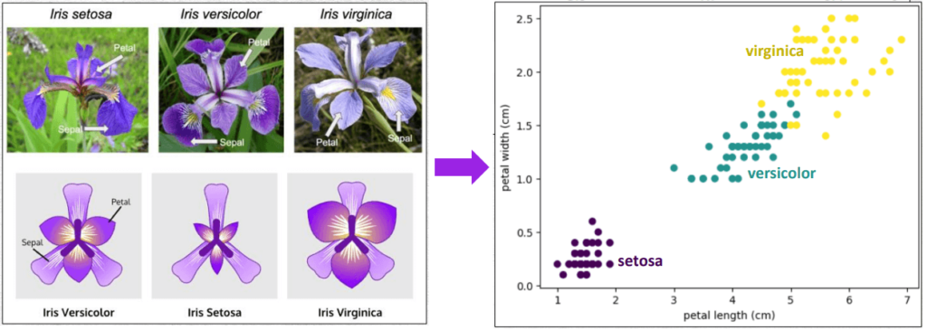

Slide 5
# DataFlair Iris Flower Classification # Import Packages import numpy as np import matplotlib.pyplot as plt import seaborn as sns import pandas as pd # Caminho do arquivo url = "https://archive.ics.uci.edu/ml/machine-learning-databases/iris/iris.data" # Define o nome das colunas header = ['sepal_length', 'sepal_width', 'petal_length', 'petal_width', 'species'] # Lê e carrega o arquivo para a memória iris = pd.read_csv(url, header=None, names=header) sns.set(style="ticks", color_codes=True) print(iris.head()) sns.pairplot(iris, hue="species", palette="husl", markers=["o", "s", "D"]) plt.show()

